Slide 1
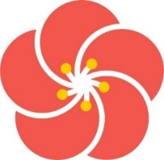
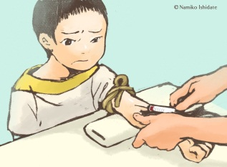
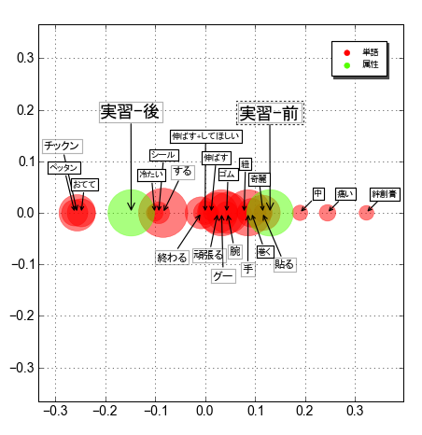
Onomatopoeias used by Nurse Students toward Preschool Patients: Before and after Pediatric Nursing Training Miyako, ISHIDATE, RN , PhDª ; Takehiko, ITO, PhD^{b} ; Tadasu, OYAMA, PhD^{c} ª Tokoha University, ^{b} Wako University, ^{c} Nihon University, Japan
INTRODUCTION Onomatopoeias are the group of words that imitate sounds or feelings. Nurses in pediatric wards often use onomatopoeias, which are considered to be the words that preschool children with immature language ability can intuitively understand. In this study, words of explanations used by 160 nurse students for preschool children who were to take venipuncture were analyzed with a questionnaire, in comparison between before and after pediatric nursing training.
After training
Before training
Table.1 Characteristic onomatopoeias used by the students toward preschool children who were to take venipuncture and comparison between before and after the training.
Chikkun
Shiiru
Nobasu+shitehosii
Pettan
Tsumetai
Suru
Nobasu
Himo
Gomu
Otete
Gomu
Kirei
Naka
Itai
Bansoko
Owaru
Ganbaru
Ude
Maku
Haru
Guu
Te
Figure.1 Correspondence analysis of the words toward preschool children who were to take venipuncture and comparison between before and after the training.
RESULTS Figure 1 shows the relationship between before/after the training and the words used by the students by the distance on the chart. Onomatopoetic words like “Chikkun”, “Pettan”, were used after the training, while adult usual words like “Nobasu”, “Himo”, “Maku” had been used often before the training. Table 1 shows the results of statistical test comparing before and after the training.
METHODS Correspondence analysis and extraction of characteristic onomatopoeias were done with “Text Mining Studio ver.4.2”, a linguistic analysis software.
DISCUSSION The differences between before and after pediatric nursing training were confirmed to be statistically significant, suggesting that the students successfully learned explanation skills required in pediatric wards thorough pediatric nursing training.
This study was partly supported by MEXT Grand-in-Aid for Challenging Exploratory Research #24660030.
Correspondence: Miyako Ishidate
1 - 30, Mizuochicho, Aoi-ku, Shizuoka-shi, Shizuoka-ken,
420-0831, Japan.
Phone: +81-54-297-3228
Email: mishidate@sz.tokoha-u.ac.jp

